Slide 1

#MassiveSeq

Slide 2
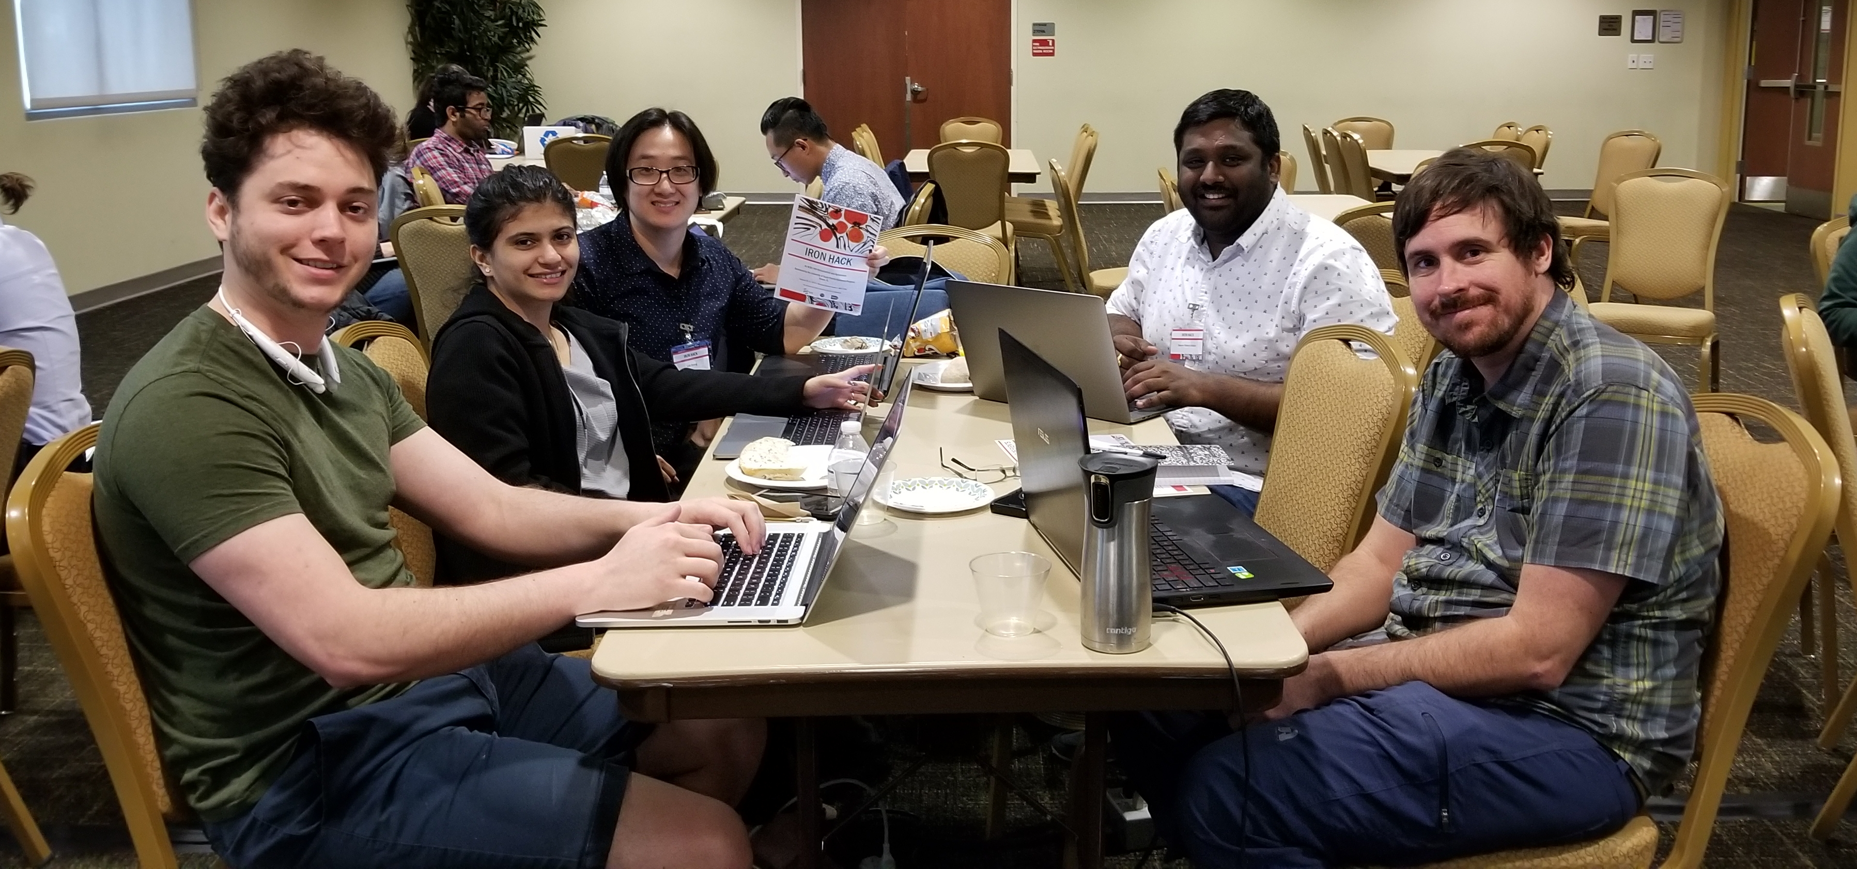
#MassiveSeq
Team Members
(in alphabetical order)
Swamy Rakesh Adapa
Linh M. Duong
Doug Franz
Shivani Kapadia
Thomas Keller

Slide 3
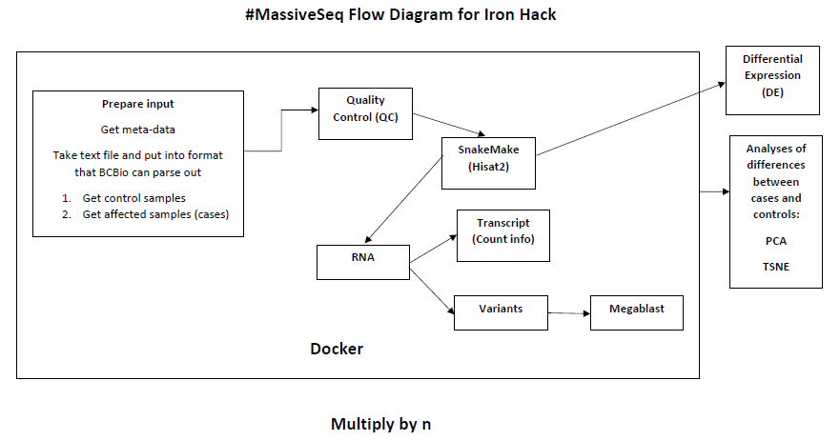

Slide 4
Pipeline
Using SnakeMake to run a batch of jobs on the clusters (automate process) to get through 99 samples
Intermediate step run every sample through
Last step is process with FeatureCounts (raw counts) to get to differential expression analyses

Slide 5
Post-processing
Use R package in post-processing
Do one initial pass of meta-analyses with Meta-Seek package
Come back and look at other ways of classifying case and control samples by binning genes based on those classes

Slide 6
Expression Analyses
Compare cases and controls among 4 datasets
What are variations between datasets?
Make our own methods or use package already established?

Slide 7
Limitations
Reinforcing the between study batch effects
If we took all the data at once and look at clustering on their own, different conclusions may be reached

Slide 8
Future Directions
Expanding out the GATK variant calling
Make system fully parallel where we can run all samples at once
Right now we can only run 12 samples at a time

